Slide 1
PM2.5 Machine Learning
By: Preetham Pangaluru
Mentor: Dr. Jonathan Jiang

Slide 2
PM2.5 Data Set:
Using APIs to get data from OpenAQ with a
base url = "https://api.openaq.org/v1/measurements?"
PM2.5 Data set from Jan 01, 2018 – Dec 31, 2021
which was made into daily, monthly, and seasonal average data as well

Slide 3
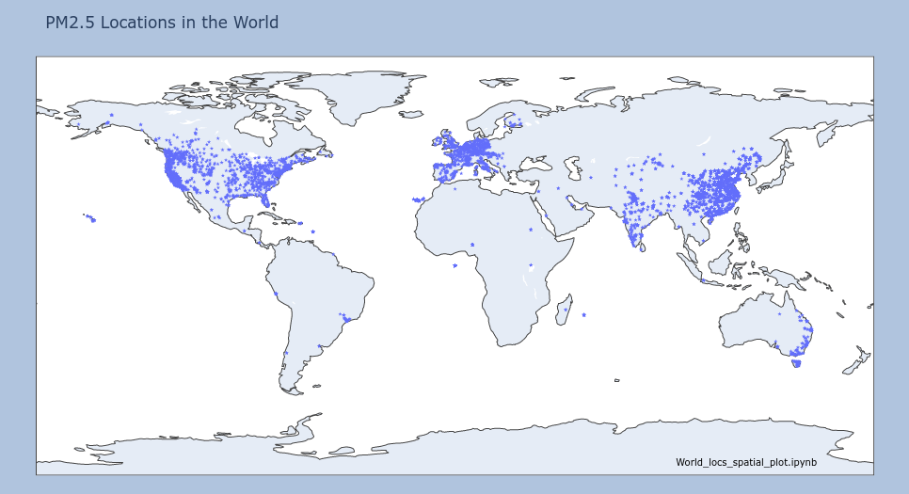
Fig. 1: PM2.5 locations around the world

Slide 4

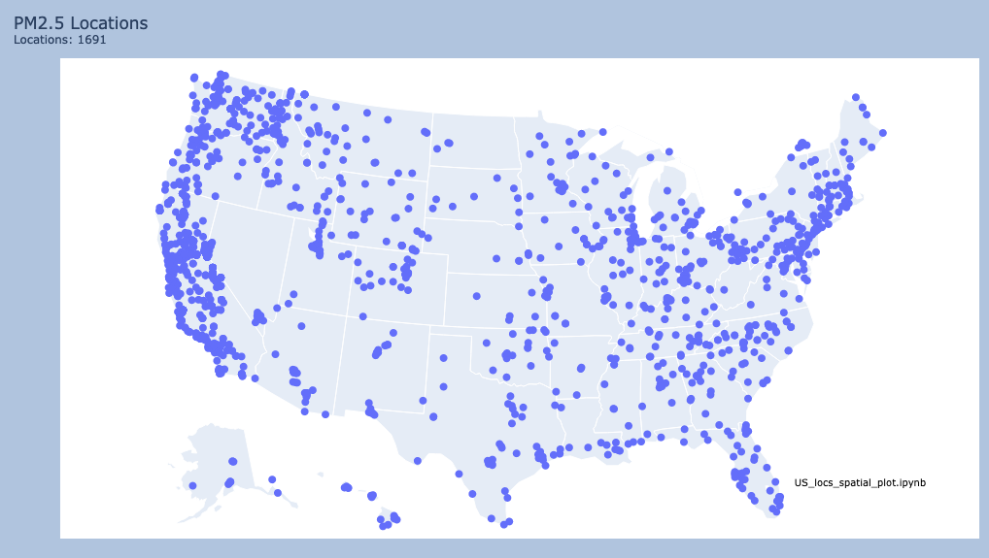
Fig. 2: PM2.5 USA locations, the total number of locations are 1691

Slide 5
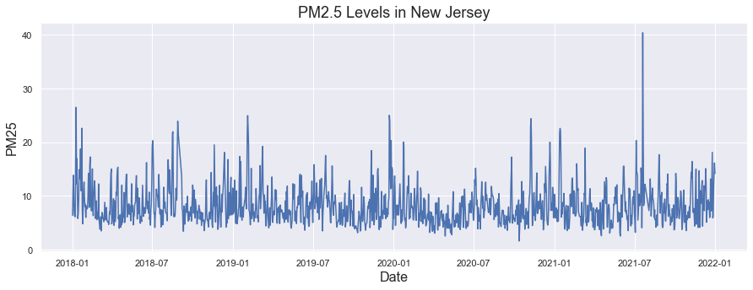
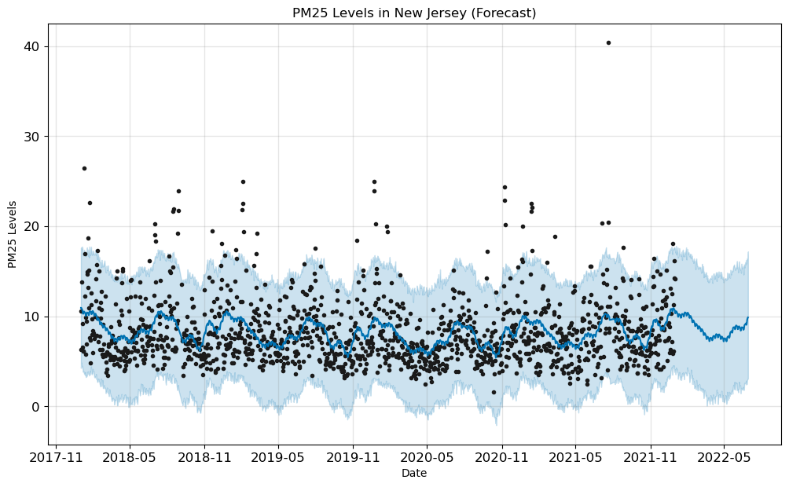
Fig.3: Daily PM2.5 time series (top) and bottom forecast predictions.

Slide 6
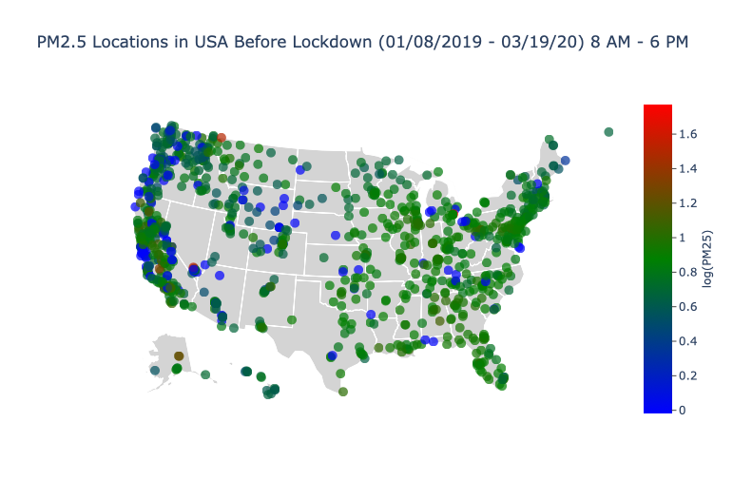
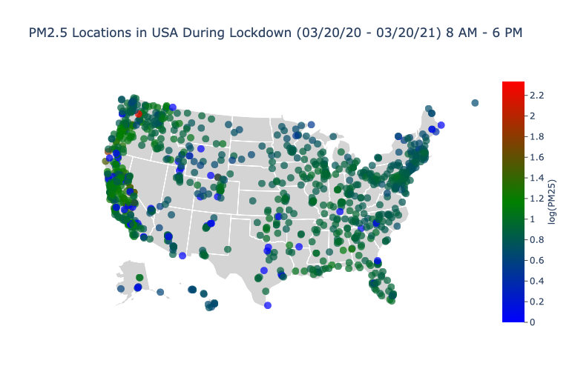
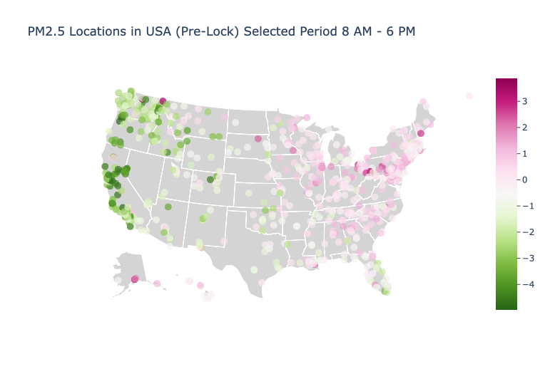
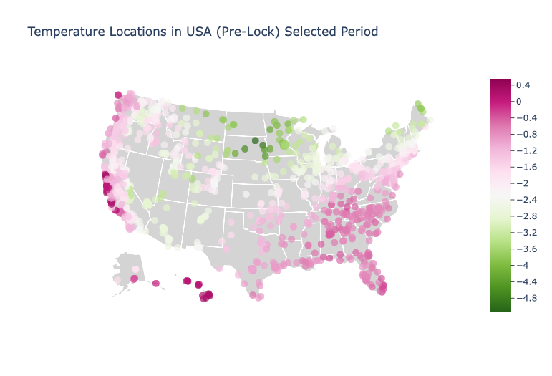

Slide 7
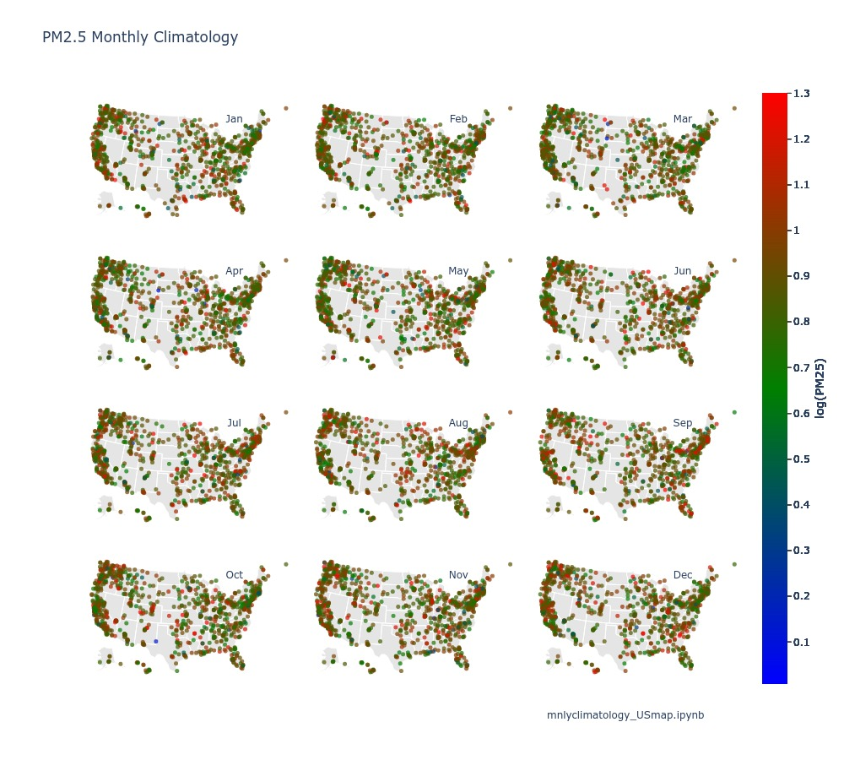
Fig. PM2.5 monthly climatology over each location during Jan 2018 – Dec 2021.

Slide 8
Fig.: Monthly PM2.5 anomalies for different years (2018 – 2021)

Slide 9
Fig.: USA monthly anomalies during the period from 2018 to 2021.

Slide 10
Fig.: California PM2.5 daily time series (blue) and predictions (red) for different ML models

Slide 11
Fig.: PM2.5 observed and predicted scatter plot for different ML models

Slide 12
Table

Slide 13
Conclusions:

